Slide 1



Heterogeneity in Tomography
Three classes of object
30000 projections are taken from the three classes of objects shown above. Our first task is to cluster the projections such that each cluster contains projections from just one class.

Slide 2
Forming pure clusters and assigning them
The projections are clustered into 300 groups and the L2-norm is used for this.
Additionally the a filtering step is also performed for each of the clusters and it is observed that the purity of cluster improves after this step.
After forming pure clusters, a denoising step is performed after which the clusters are grouped into three equal parts using their zeroth-moment and are assigned class numbers 1, 2 and 3.
An experiment is performed to test the accuracy of these assignments.

Slide 3
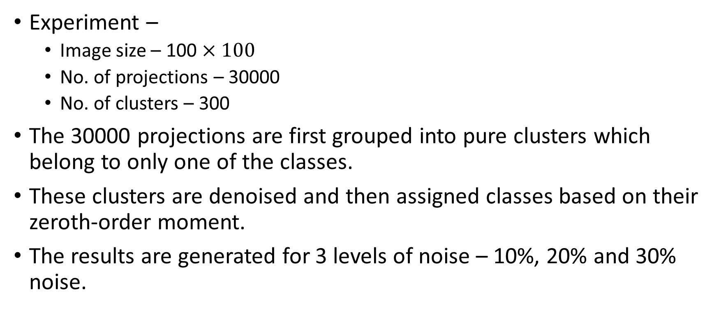
Clustering based on zeroth-moment
Experiment –
Image size – 100 $×100$
No. of projections – 30000
No. of clusters – 300
The 30000 projections are first grouped into pure clusters which belong to only one of the classes.
These clusters are denoised and then assigned classes based on their zeroth-order moment.
The results are generated for 3 levels of noise – 10%, 20% and 30% noise.

Slide 4
Clustering based on zeroth-moment
10% noise
20% noise
Class | Total | Correct | Incorrect | Percentage Correct
1 | 99 | 99 | 0 | 100%
2 | 97 | 97 | 0 | 100%
3 | 104 | 100 | 4 | 96.15%
Class | Total | Correct | Incorrect | Percentage Correct
1 | 87 | 87 | 0 | 100%
2 | 104 | 101 | 3 | 97.12%
3 | 109 | 105 | 12 | 96.33%

Slide 5
Clustering based on zeroth-moment
30% noise
Class | Total | Correct | Incorrect | Percentage Correct
1 | 93 | 93 | 0 | 100%
2 | 100 | 100 | 0 | 100%
3 | 107 | 100 | 7 | 93.46%

Slide 6
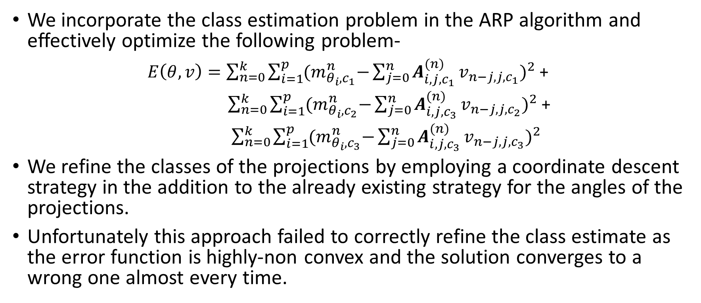
Refinement of Clusters
We incorporate the class estimation problem in the ARP algorithm and effectively optimize the following problem-
$E\left(θ, v\right)=\sum_{n=0}^{k}{\sum_{i=1}^{p}{{(m}_{θ_{i},c_{1}}^{n}−{{\sum_{j=0}^{n}{A_{i,j, c_{1}}^{(n)}}v}_{n−j, j,c_{1}})}^{2}}}$ +
$\sum_{n=0}^{k}{\sum_{i=1}^{p}{{(m}_{θ_{i},c_{2}}^{n}−{{\sum_{j=0}^{n}{A_{i,j,c_{3}}^{(n)}}v}_{n−j, j,c_{2}})}^{2}}}$+
$\sum_{n=0}^{k}{\sum_{i=1}^{p}{{(m}_{θ_{i},c_{3}}^{n}−{{\sum_{j=0}^{n}{A_{i,j,c_{3}}^{(n)}}v}_{n−j, j,c_{3}})}^{2}}}$
We refine the classes of the projections by employing a coordinate descent strategy in the addition to the already existing strategy for the angles of the projections.
Unfortunately this approach failed to correctly refine the class estimate as the error function is highly-non convex and the solution converges to a wrong one almost every time.

Slide 7
Alternate approach
Instead of using the moment-based approach to refine the class estimates we can use the moment-based approach to provide us with the initial estimate for each of the classes.
The classes of the cluster can then be refined in the next step – The gradient descent step.
As we are calculating roughly accurate estimates for the orientation projections in the moment-based approach, the hope is that in the refinement step we’ll be able to tell with more accuracy which class a projection belongs to and thus refine the class estimates.

Slide 8
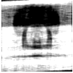
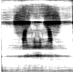
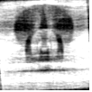
Moment-Based Estimate
Class 1 Estimate
Class 2 Estimate
Class 3 Estimate

Slide 9
Refinement of Clusters-Modified
The moment-based approach is applied separately for each of the classes and the angles are estimated for each of those classes.
After estimating the angles of the clusters, we reconstruct the images for the three classes which serve as our initial estimate for the gradient descent approach.
We do a separate gradient descent step for each class to refine.
Then, for each cluster we assign the class which gives the projection along the current theta estimate most similar to the cluster in the L2-norm sense.

Slide 10
Wrong assignment of classes
Due to noise and not very good initial models, the clusters are assigned wrong classes.
This assignment of wrong class sticks in the later iterations and leads to other wrong assignments.
The reason this is happening is because we are drastically assigning a new class to each cluster based on the initial iterations. Instead of simply assigning a class to each cluster what we can do is assign the probabilities of a cluster belonging to each of the three classes.

Slide 11

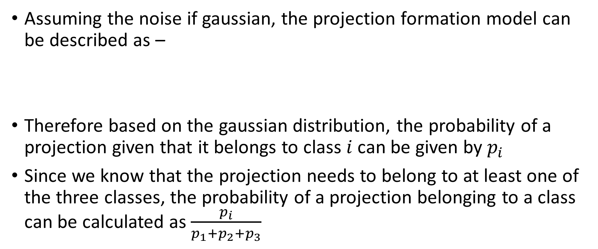
Probability of cluster belonging to a class
Assuming the noise if gaussian, the projection formation model can be described as –
Therefore based on the gaussian distribution, the probability of a projection given that it belongs to class $i$ can be given by $p_{i}$
Since we know that the projection needs to belong to at least one of the three classes, the probability of a projection belonging to a class can be calculated as $\frac{p_{i}}{p_{1}+p_{2}+p_{3}}$

Slide 12
Final Refinement Procedure
While reconstructing the image, we account for the probability of a projection belonging to that image.
This can be done by reconstructing the image using projections multiplied with their respective probabilities.
After reconstructing the image, we calculate the new probabilities of each cluster using the refined image.
The hope is that even if the probability of a projection belonging to a incorrect class is high at first, over the iterations, it gradually will converge towards the right class.

